Slide 1
Advances in DNA Sequencing
Biochem 3BP3
November 26, 2025

Slide 2
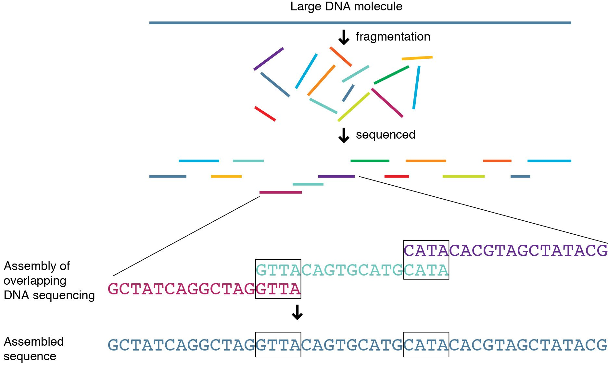
Sequencing we have learnt about so far …
Illumina DNA sequencing
Shot gun approach
Sequence small fragments about 250 base pairs in length
Can use some library prep tricks to measure additional information: RNA-seq, ChIP-seq, Bisulfite-seq
Limitations:
1. Short reads which can reduce alignment efficiency
2. Sequencing multiple cells together, read out is an average

Slide 3
Advances in sequence length and resolution
1
Sequence length
2
Single cell resolution
3
Spatial resolution

Slide 4
Advances in sequence length and resolution
1
Sequence length
2
Single cell resolution
3
Spatial resolution
a
Nanopore
b
PacBio

Slide 5
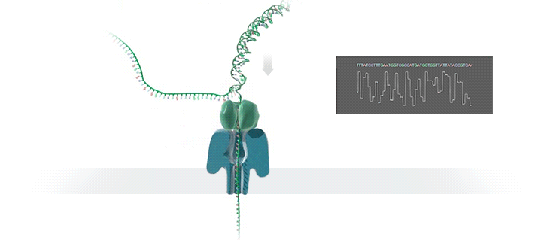
Oxford Nanopore Technologies (ONT)
Protein nanopore is set in an electrically resistance polymer membrane.
An ionic current is passed through the nanopore by setting a voltage across membrane.
Change in current used to identify molecule passing through.
Each nanopore sequences a single DNA molecule start to finish – no fixed read length
Can detect modifications, e.g. DNA methylation

Slide 6
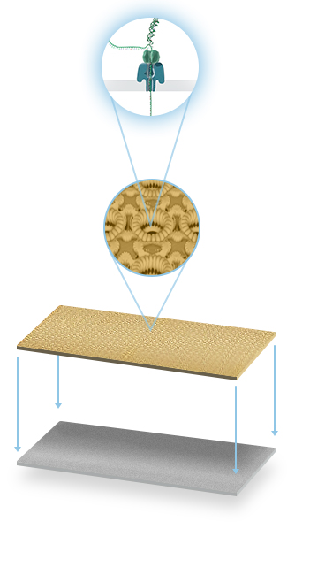
Oxford Nanopore Technologies (ONT)
Protein nanopore is set in an electrically resistance polymer membrane.
An ionic current is passed through the nanopore by setting a voltage across membrane.
Change in current used to identify molecule passing through.
Each nanopore sequences a single DNA molecule start to finish – no fixed read length
Can detect modifications, e.g. DNA methylation

Slide 7
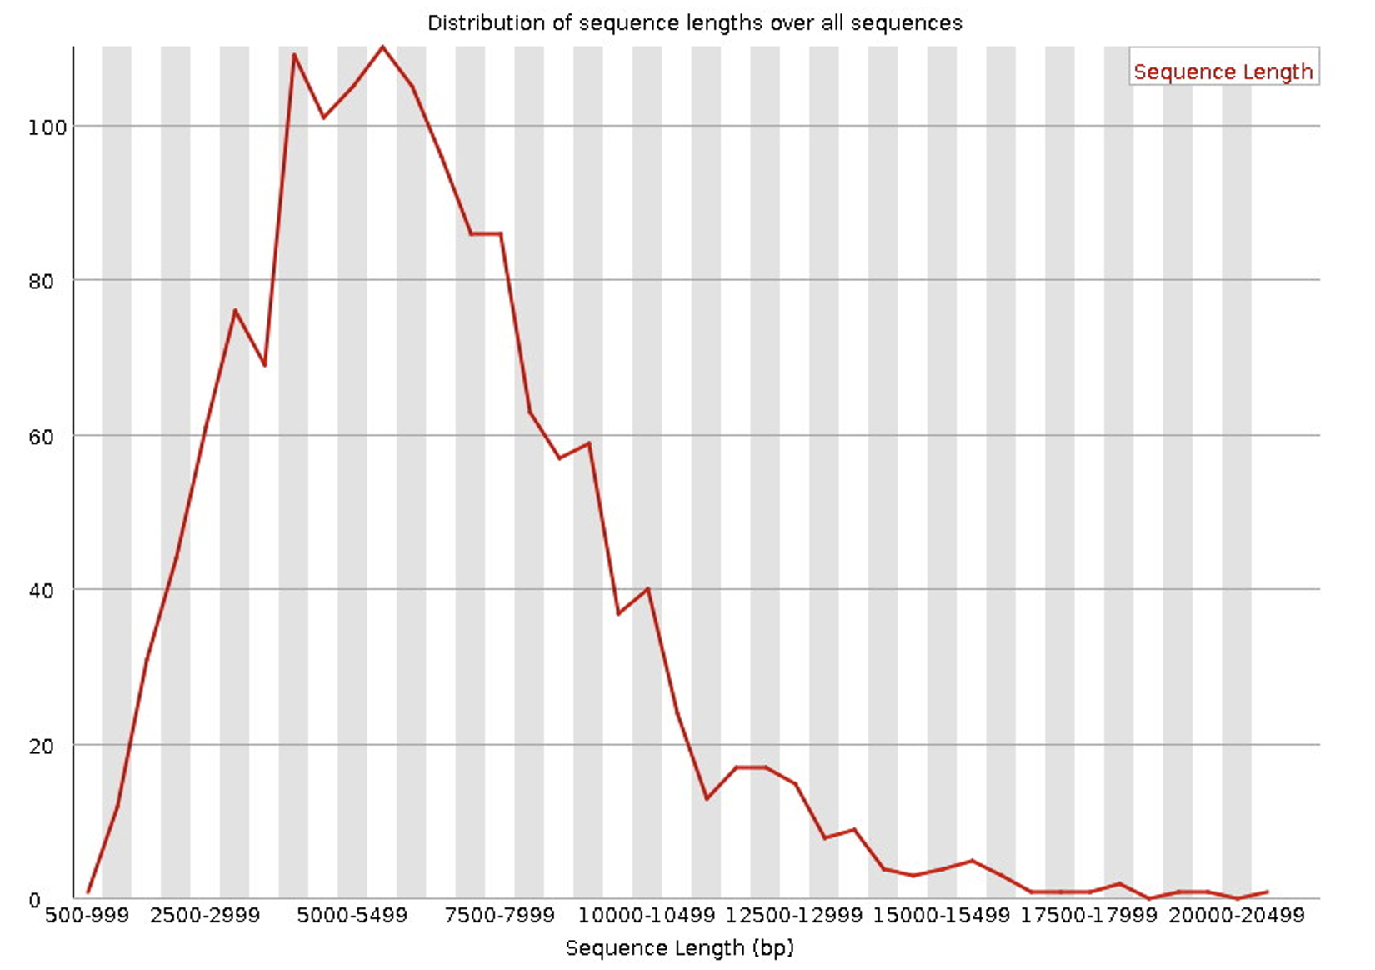
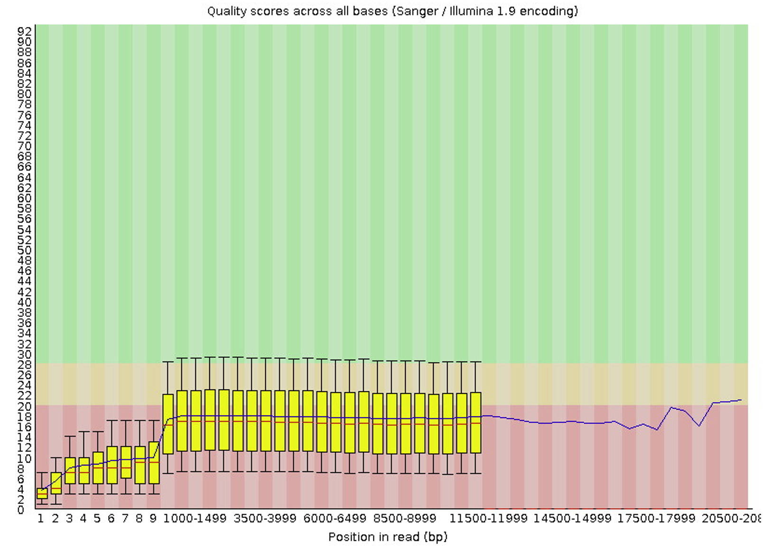
Trade-off: long reads vs base calling accuracy
Very long reads – longest reported 10 Mbp
Low base accuracy – low PHRED score
1478 total sequences produced by sequencing a bacterial pathogen

Slide 8
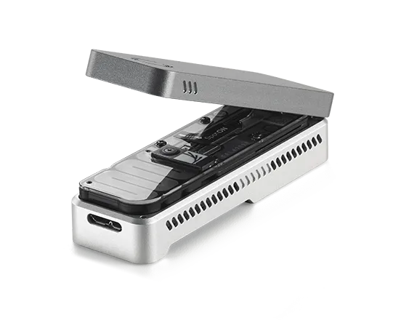
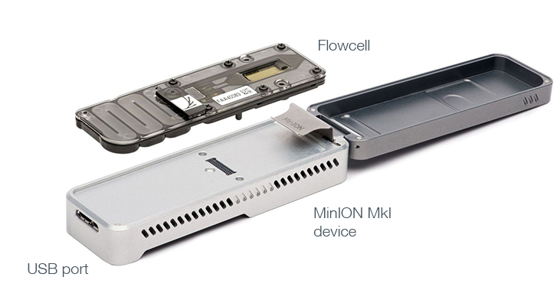
Nanopore portable, real-time analysis
MinION
Flow cell and device very small and portable
Easy to use – no PCR step involved
DNA strand moves rapidly are rate 1-5 μs per base through the nanopore
Processing this fast signal not fully mature
May be the first technology for clinical virus sequencing and outbreak management

Slide 9
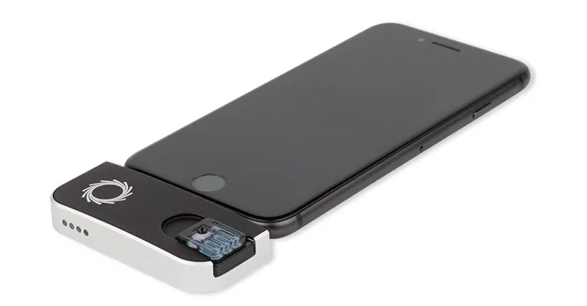
Nanopore portable, real-time analysis
MinION
Flow cell and device very small and portable
Easy to use – no PCR step involved
DNA strand moves rapidly are rate 1-5 μs per base through the nanopore
Processing this fast signal not fully mature
May be the first technology for clinical virus sequencing and outbreak management
SmidgION
(In development)

Slide 10
Advances in sequence length and resolution
1
Sequence length
2
Single cell resolution
3
Spatial resolution
a
Nanopore
Strengths:
Read length
Portability
b
PacBio

Slide 11
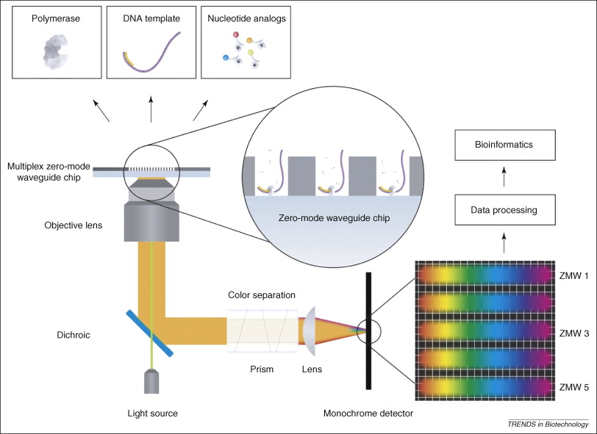
Pacific Biosciences (PacBio)
Single Molecule, Real Time (SMRT) Technology
Sequence by synthesis method using phospholinked nucleotides and zero-mode waveguide (ZMWs) sensor
Single DNA polymerase enzyme is affixed at the bottom of a ZMW with a single molecule of DNA as a template
Immobilized DNA polymerase is stable enough for long reads
Illuminated volume: ~20 zeptoliters (20 X 10⁻²¹ liters)

Slide 12
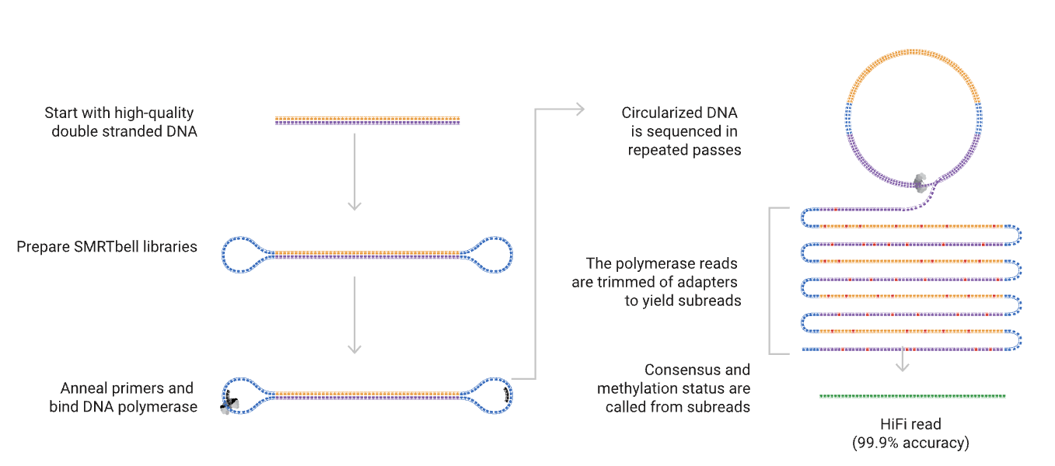
HiFi Sequencing – increasing base accuracy

Slide 13
Which platform to choose? Nanopore vs PacBio
 | Nanopore | PacBio
Read length | 100 kbp (1-4 Mbp possible) | 10-25 kbp
Base pair accuracy | Q17-20 (98-99%) | Q30-50 (99.9-99.99%)
Portable | Yes | No

Slide 14
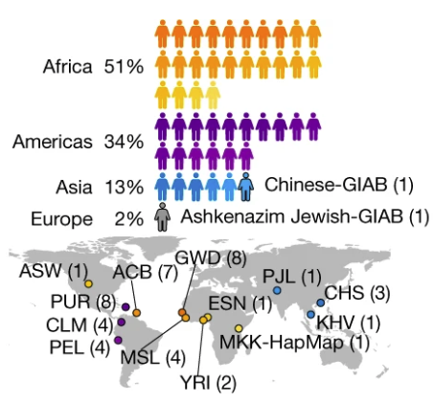
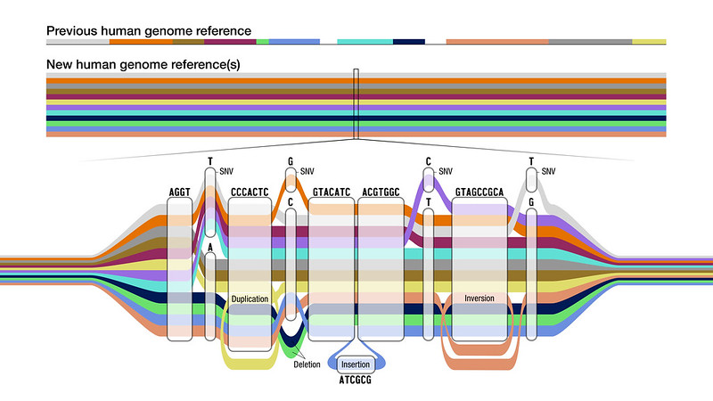
Leveraging long-read technologies
Constructing the first human pangenome reference
Liao et al. Nature 2023

Slide 15
Leveraging long-read technologies
Constructing the first human pangenome reference
Four different sequencing methods:
PacBio HiFi
ONT long read
Bionano optical mapping
Illumina short read sequencing
Liao et al. Nature 2023

Slide 16
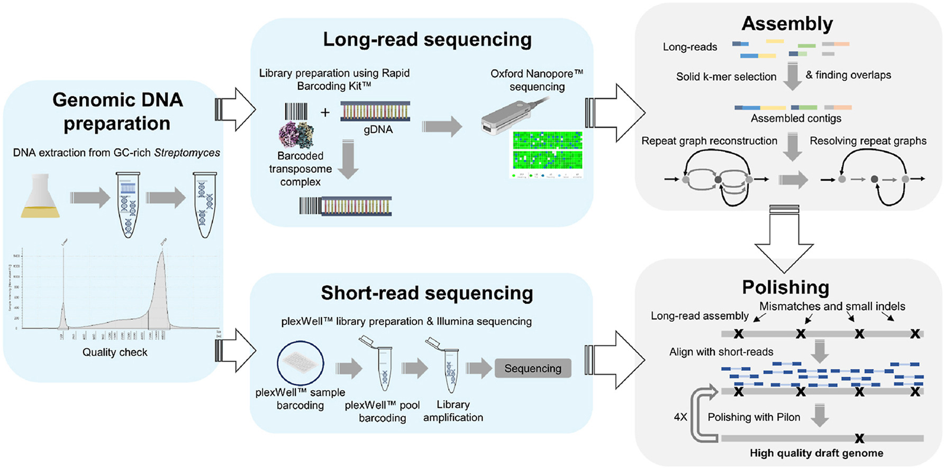
Leveraging long-read technologies
Heng et al. Synthetic and Systems Biotechnology 2023

Slide 17
Advances in sequence length and resolution
1
Sequence length
2
Single cell resolution
3
Spatial resolution
a
Nanopore
Strengths:
Read length
Portability
b
PacBio
Strengths:
Base accuracy

Slide 18

Advances in sequence length and resolution
1
Sequence length
2
Single cell resolution
3
Spatial resolution
a
Nanopore
Strengths:
Read length
Portability
a
10X Genomics
b
PacBio
Strengths:
Base accuracy

Slide 19
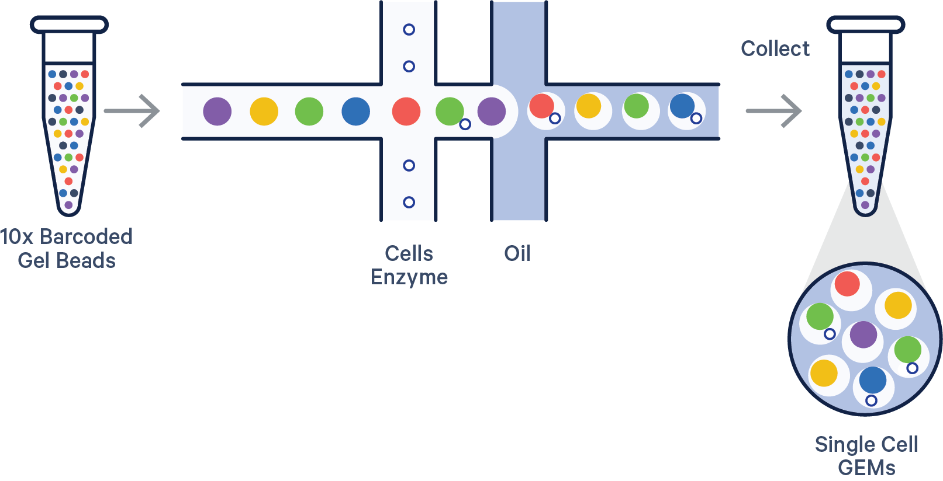
10X Genomics: single cell sequencing
Combines cell sorting with sequencing to measure single-cell transcriptome.
Individual cells are separated into Gel Beads in EMulsion (GEMs) along with barcoded gel beads and reverse transcriptase/reagents.

Slide 20
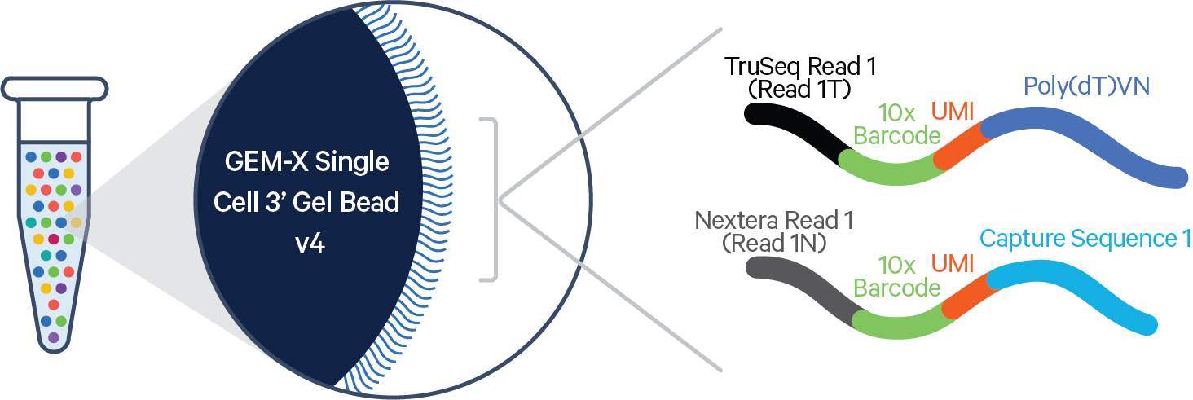
10X Genomics: single cell sequencing
Cell is lysed within GEM, mRNA anneals to bead’s oligos. RNA is reverse transcribed in cDNA such that every cDNA has: 10x barcode + UMI + cDNA sequence
cDNA sequence = which gene
UMI (unique molecular identifier) = which RNA molecule
10x barcode = which cell
50-100bp
Does not sequence full transcript

Slide 21
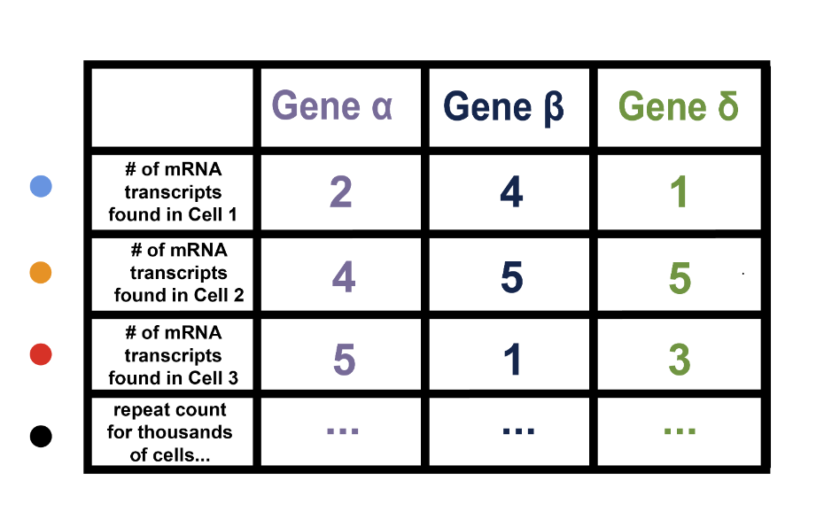
Questions that can be answered with scRNA-seq

Slide 22
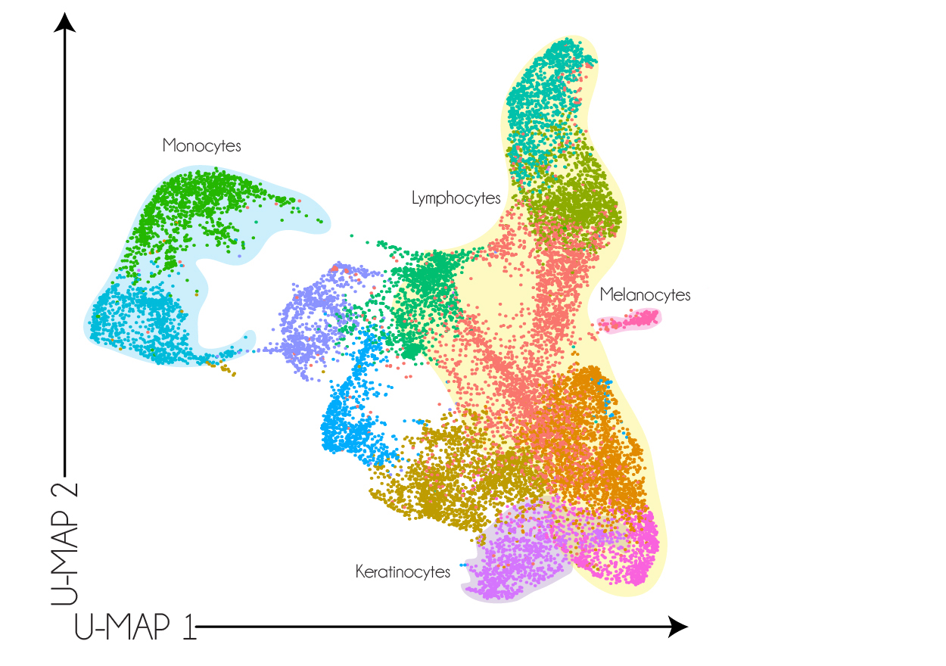
Questions that can be answered with scRNA-seq
What proportion of the cells sequenced are immune cells/stromal cells/epithelial cells/etc.?
Is a specific gene expressed by a specific cell type?
Can we identify a novel cell type based on its transcriptome?

Slide 23
Advances in sequence length and resolution
1
Sequence length
2
Single cell resolution
3
Spatial resolution
a
Nanopore
Strengths:
Read length
Portability
a
10X Genomics
Limitations:
Limited to gene abundance
Does not sequence full transcript
No spatial resolution
b
PacBio
Strengths:
Base accuracy

Slide 24
Advances in sequence length and resolution
1
Sequence length
2
Single cell resolution
3
Spatial resolution
a
Nanopore
Strengths:
Read length
Portability
a
10X Genomics
Limitations:
Limited to gene abundance
Does not sequence full transcript
No spatial resolution
b
PacBio
Strengths:
Base accuracy

Slide 25
Advances in sequence length and resolution
1
Sequence length
2
Single cell resolution
3
Spatial resolution
a
Nanopore
Strengths:
Read length
Portability
a
10X Genomics
Limitations:
Limited to gene abundance
Does not sequence full transcript
No spatial resolution
a
10X Genomics Visium
b
PacBio
Strengths:
Base accuracy

Slide 26
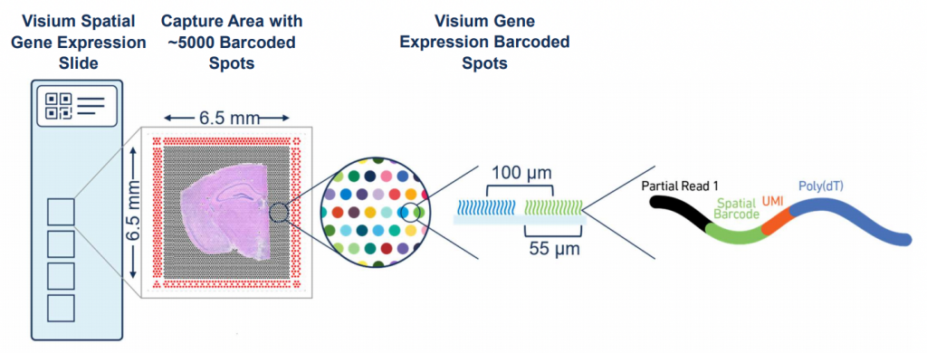
10X Genomics: Visium
Tissue is overlaid on Visium gene expression slide which includes barcoded spots.
Tissue is permeabilized which releases mRNA and allows to hybridize with barcodes.
Average size of cell: 10-20 µm

Slide 27
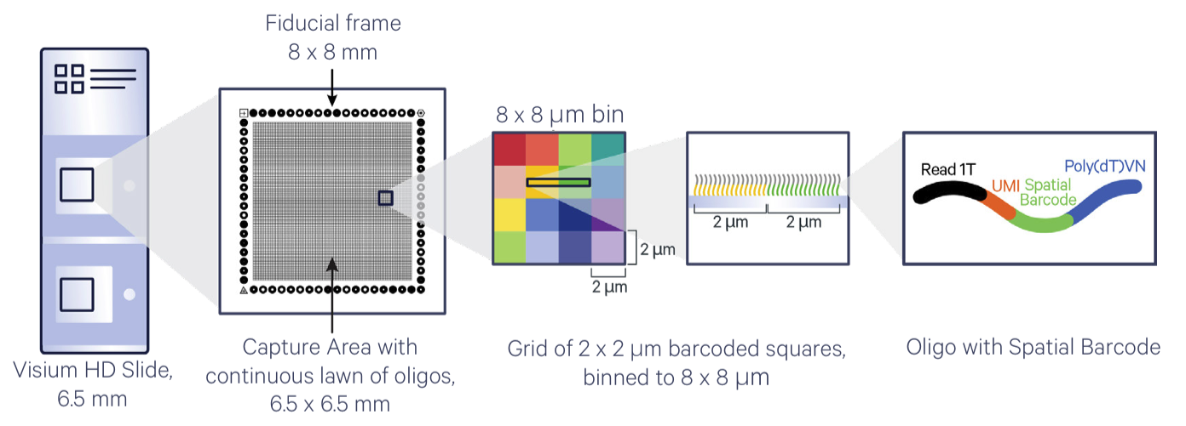
10X Genomics: Visium HD
Visium HD contains spatially barcoded oligos arranged in a grid of 2 x 2 µm barcoded squares which effectively achieves single cell resolution
Average size of cell: 10-20 µm

Slide 28
Questions that can be answered with Visium
What proportion of the cells sequenced are immune cells/stromal cells/epithelial cells/etc.?
Is a specific gene expressed by a specific cell type?
Can we identify a novel cell type based on its transcriptome?

Slide 29
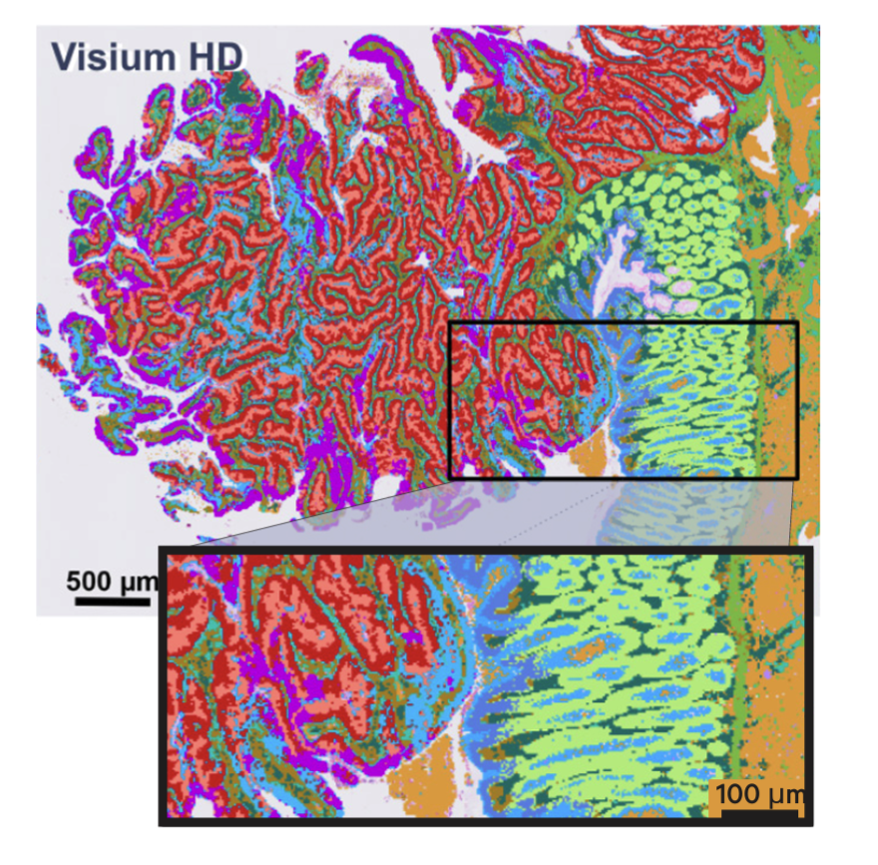
Questions that can be answered with Visium
What proportion of the cells sequenced are immune cells/stromal cells/epithelial cells/etc.?
Is a specific gene expressed by a specific cell type?
Can we identify a novel cell type based on its transcriptome?
How does the spatial proximity of cell A impact the transcriptional phenotype of cell B?
Do specific cell types co-localize?

Slide 30
Advances in sequence length and resolution
1
Sequence length
2
Single cell resolution
3
Spatial resolution
a
Nanopore
Strengths:
Read length
Portability
a
10X Genomics
Limitations:
Limited to gene abundance
Does not sequence full transcript
No spatial resolution
a
10X Genomics Visium
Limitations:
Limited to gene abundance
Does not sequence full transcript
b
PacBio
Strengths:
Base accuracy

Slide 31
Advances in sequence length and resolution
1
Sequence length
2
Single cell resolution
3
Spatial resolution
a
Nanopore
Strengths:
Read length
Portability
a
10X Genomics
Limitations:
Limited to gene abundance
Does not sequence full transcript
No spatial resolution
a
10X Genomics Visium
Limitations:
Limited to gene abundance
Does not sequence full transcript
b
PacBio
Strengths:
Base accuracy

Slide 32


This week …
Next week ... Guest lecture from Dr. McArthur
The Genomics of a Pandemic
Notes:
McA

